Slide 1
Name:
Dom Hill
In this unit you will learn about:
How to investigate and discuss Computer Science technologies.
How key stakeholders are affected by technologies.
Environmental impact of Computer Science.
Cultural implications of Computer Science.
Open source vs proprietary software.
Legislation relevant to Computer Science.
Grade | Target | Depth | Understanding | Comment
7-9 |  | All aspects complete | All work is accurate
5-6 |  | Most aspects complete | Most work is accurate
3-4 |  | Some aspects complete | Some work is accurate
1-2 |  | Little work complete | Little work is accurate
Response:
Notes:
Unit description and mark scheme.

Slide 2
How to investigate and discuss Computer Science technologies
Computer Technology
Storing passwords and secure information
Microphone security
Webcam security
Produced sustainably
Computer doesn’t blow up when opening chrome
When new computer technologies are introduced, a number of issues need to be considered in addition to the technical feasibility of any solution. These include:
Notes:
1. Complete the ovals to state the range of issues that should be considered when discussing computer technology.

Slide 3
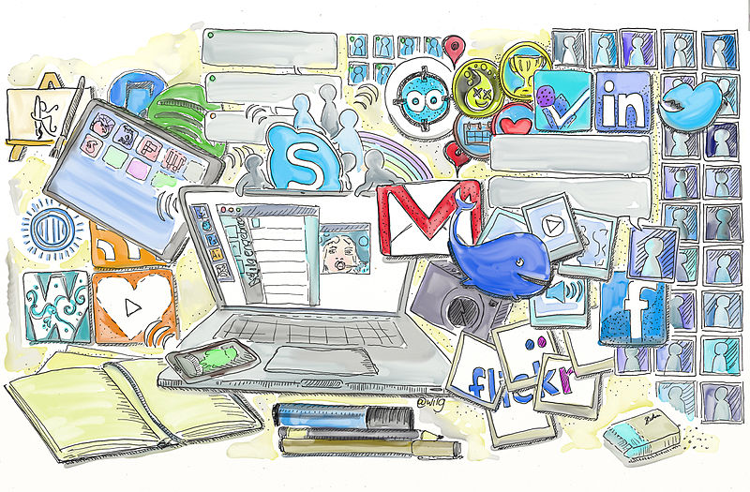
Ethical issues
The internet has given rise to an increase in piracy, distribution of illegal images, offensive content, fraud, trolling and other inappropriate actions. Should the internet be regulated? Should internet service providers have a responsibility for content delivered to their customers? Should social networks be responsible for the content posted to their sites?
Arguments for:
Social networks should be responsible in handling issues like bullying and fraudulent accounts for the safety of their own users.
The internet should be regulated so criminals can be stopped (however it is very easy to hide your identity on the internet)
Arguments against:
The internet shouldn’t be regulated too strongly as that will go against free speech
A private ISP should not be controlled by a government.
My opinion:
Yes
No
My conclusion:
I think that the internet should be somewhat regulated however the public should have full access to information that they deserve.
Notes:
State the arguments for.
State the arguments against.
Drag the purple pin on the opinion line, to show what your opinion is. You don’t have to be of the opinion yes or no, show your strength of feeling one way or the other.
Justify your opinion with a brief conclusion. What are the key arguments for you?

Slide 4

Ethical issues
Question:
- This house believes the impact of social media on teenage mental health is damaging
Picture here
Arguments for:
Cyberbullying is common with teenagers on social media. Cyberbullying can have a huge effects on teenage mental health, with many cases of teen suicides linked to harassment social media.
Social media can become addicting and users can change due to it.
Social media set expectations high in terms of looks. Many teenagers become insecure when seeing models and good looking on Instagram constantly. This can lower their self-esteem
Arguments against:
Using social media allows teenagers to learn more about the world. The right apps and accounts can help you learn a lot about how society works and what is right and wrong. This can help a lot of teenagers who have been shielded from the real world from their parents.
Apps like snapchat allow users to talk to their friends online. This reduces loneliness, especially during times like now
My opinion:
Yes
No
My conclusion:
I think that social media can be damaging to mental health but if you stay aware online, and stay out of trouble, you’ll be fine. Social media can be very beneficial.
Notes:
Research one of these ethical issues of computer science. - This house believes the impact of social media on teenage mental health is damaging; - This house believes that tracking software on mobile devices is an invasion of privacy; - This house believes that computer games have a negative impact on the social behaviour of children. - This house believes that the advancement of computer technology is creating a “digital divide”. - This house believes that the DNA sequence of every person should be kept on an international database for crime prevention.
Complete the slide outlining the key points from your research, and your own opinions.
If you have time, copy this slide and tackle another ethical issue.

Slide 5
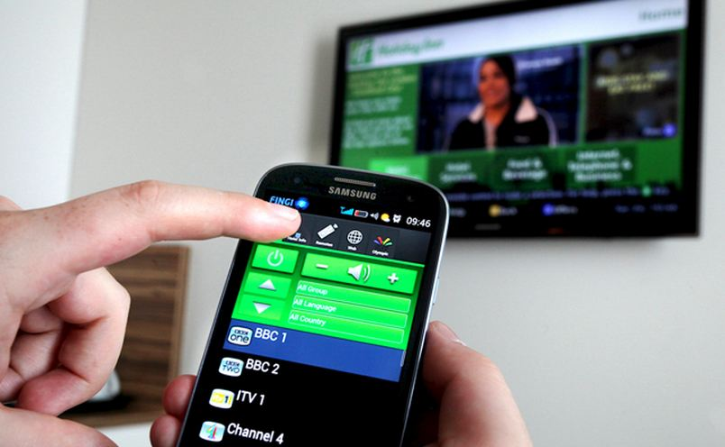
Privacy issues
An increasing range of smart devices in our homes are voice activated, and are capable of listening in to our daily activities. Some people argue that the Government are collecting valuable information for counter-terrorism operations using this technology. Should smart devices be allowed to be continually recording?
Arguments for:
Allowing the devices to continually record will increase the possibilities of the smart device
If the government are collecting information, it wont affect you unless you are a terrorist, so the changes won’t affect you
Arguments against:
The government shouldn’t be able to record us without our permission as this is an invasion of our own privacy.
The government could use this private information against us, or the technology may not just be used for counter-terrorism purposes
My opinion:
Yes
No
My conclusion:
I think that it is okay for devices to be continually recording in order to listen for keywords like ‘alexa’ however the recordings should not be stored without the user knowing, and there should be an option to mute the microphone on the smart device.
Notes:
State the arguments for.
State the arguments against.
Drag the purple pin on the opinion line, to show what your opinion is. You don’t have to be of the opinion yes or no, show your strength of feeling one way or the other.
Justify your opinion with a brief conclusion.

Slide 6
Legal issues
Eight principles of the Data Protection Act 1998:
Copyright Designs and Parents Act 1988 makes it illegal to:
Data should be processed fairly and lawfully: not obtained by deception
Data should only be used for the purpose specified
Data should be relevant and not excessive
Data should be accurate and up to date
Data should only be kept for as long as is necessary
Individuals have a right to see the data held about them, and to correct it.
Data must be kept secure
Data cannot be transferred outside the EU unless the country has adequate data protection laws
Copy, modify or distribute software, music, video or other intellectual property without permission from the author
The Creative Commons Licensing is:
The standardised way to grant copyright permission to create work.
The purpose of the Freedom of Information Act 2000 is to:
Provide the public access to information held by public authorities
Under the Computer Misuse Act 1990, it is illegal to:
The two principles of the Freedom of Information Act are:
Make any unauthorised access to data with intent to commit further offences
To make any unauthorised access to data with the intent to modify data, e.g. viruses
Members of the public can request information held by public bodies about their activities
Public authorities are obliged to publish this data
Notes:
State the eight principles of the Data Protection Act 1998.
State what is illegal under the Computer Misuse Act 1990.
Describe what is made illegal under the Copyright Designs and Patents Act 1988.
Explain the purpose of Creative Commons Licensing.
State the purpose of the Freedom of Information Act 2000.
State two principles of the Freedom of Information Act 2000.

Slide 7
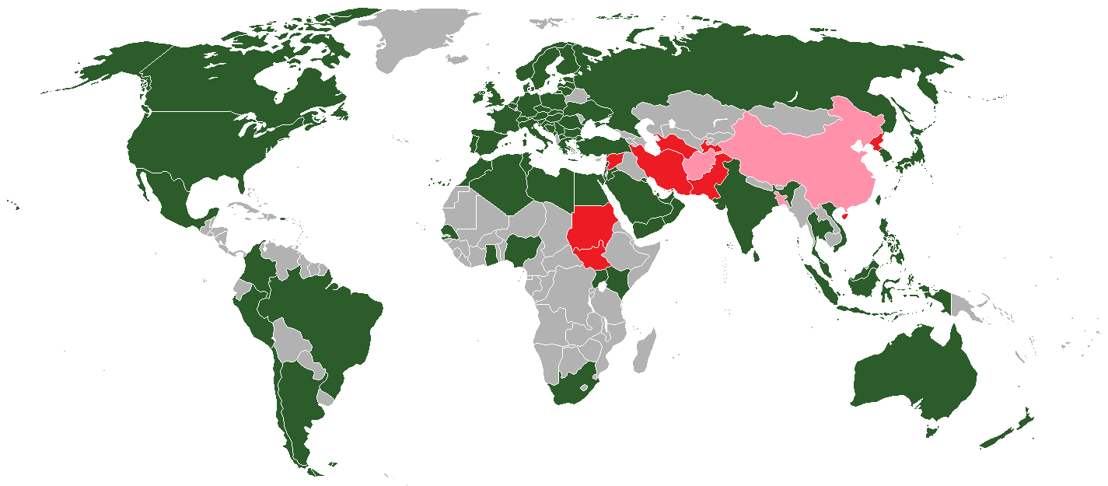
Cultural issues: censorship of YouTube
Reasons a country might block YouTube:
Limiting public exposure to content that may ignite social or political unrest
Preventing criticism of a ruler, Government or religion
Preventing violations of national laws
Preventing violations of hate speech, ethics or morality-based laws
Notes:
The countries highlighted in red block access to YouTube. Using a map of the world, label the red and pink countries highlighted. (green indicates a country has their own YouTube version, grey indicates free access, pink is previously censored) Source: https://en.wikipedia.org/wiki/Global_Internet_usage
State the reasons why a country may choose to block access to YouTube.
On the map annotate some additional cultural issues in Asia, Africa, America and Europe.

Slide 8
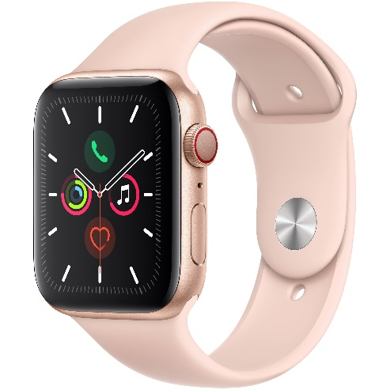



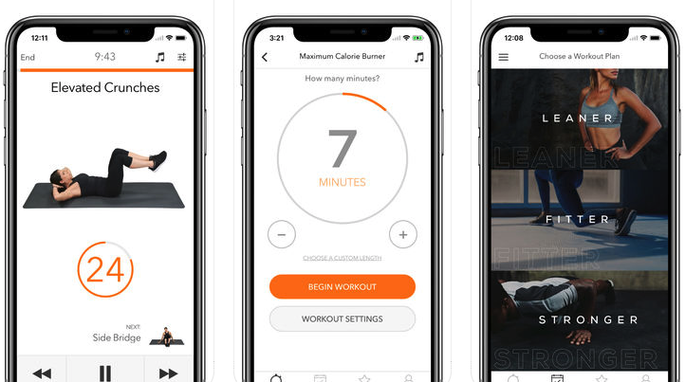


Cultural issues: a changing world
Notes:
Sarah and Abbie are two students. Illustrate a day in their life on a timeline with supporting images and explanations of how computers are changing the world they are living in for work, play, communicating, socialising and keeping fit.

Slide 9
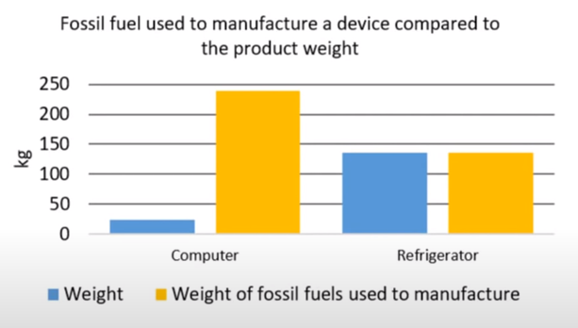
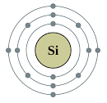


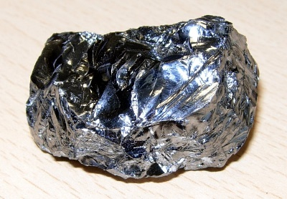

Environmental issues
Manufacturing computers
A computer can take ten times as much as its weight in fossil fuel to manufacture.
Chart here
There are only a finite number of natural resources to build computer technology with.
Picture of silicon
2%
Use
2% of the total global energy is used for data centres
Disposal
Toxic materials that computers are made of include:
Chromium
Cobalt
Cadmium
Mercury
Arsenic
One particular problem with the disposal of these materials is:
They are often dumped in poor areas and people look scavenge for metals and valuable items
Notes:
Create a chart to illustrate that a computer can take 10 times as much as its weight in fossil fuel to manufacture compared to a refrigerator: Computer weight: 24kg, fossil fuels used 240kg. Refrigerator weight: 136kg, fossil fuels used 136kg
What percentage of the total global energy use is used for data centres? Complete the ‘use’ box in a full sentence with this data.
Name five materials that computers are made of that are toxic.
State what the problem with disposal of computers might be to people living in developing countries.

Slide 10
Stakeholders case study
Scenario:
Increase in online banking, and the reduction in high street banking
CUSTOMER
COMPANY
WORKER
Impact of computer science
No need to travel to the bank
Can access the bank 24/7 and can access on mobile devices
Less personal service
Open to hacking
Less overheads like staff and rent
Large responsibilities for data protection
May lose jobs due to closure of branch
New jobs created
Need to learn new skills
Notes:
Choose one of the scenarios below, and create a spider diagram that explains the impact on three stakeholders: the customer, the workers and the company. - Increase in online banking, and the reduction in high street banking. - Increase in online shopping, and the reduction in high street shopping. - Increase in automated production, and the reduction of manual labour.

Slide 11
Stakeholders case study: NASA’s Valkyrie humanoid
What is it?
NASA’s Valkyrie humanoid, officially known as R5, was initially designed to work in disaster zones in November 2014, however extra work is now being done on the technology that could help us in the future, for example on mars.
Problems it aims to solve?
Mars is an extreme environment, and there will be many things that humans cannot do as it is too dangerous, so it will be safer to get robots to do this job. This explains why there are currently rovers on mars but not humans, robots are safer.
The Valkyrie humanoid is designed to work in environments too dangerous for astronauts.
Impact to stakeholders
Astronauts: This project can save a lot of astronauts lives as they won’t have to go into these dangerous environments as much.
Government: Although this project will cost a fair bit to the government, it will also save a lot of lives and make the mars mission easier. In comparison to the cost of the rest of the mission, the cost of this is miniscule
Other public sectors: As this technology advances, there would eventually be no jobs and the world’s economy would be entirely warped if there are no regulations put in place, but that’s a conversation for another PowerPoint.
Problems with artificial intelligence
To artificial intelligence, hard things to humans are easy and easy things to humans are hard. An example would be chess. A computer beat the chess world champion in 1997. Easy for the computer. It would be much harder for a robot to pick up the chess pieces and put them in the right place than it would to win the game as it did. Due to this, it is very hard to replicate human movements like walking, which the Valkyrie will have to be very good at. Nobody wants a toppling robot on mars.
Ethical and moral issues of artificial intelligence
Artificial intelligence brings a plethora of ethical and moral issues. Most of them include AI taking over, taking all jobs or misaligned goals of AI. There are many scenarios in which we could live in a digital utopia or in a world of so-called ‘supercapitialism’ where one company runs all the world’s AI and controls all people, including governments; the type of thing you’ll see in a dystopian film. Once again, that’s a conversation for another PowerPoint.
Notes:
Investigate NASA's Valkyrie humanoid project.
Create a scrap book page explaining: - what it is; - what problems it aims to solve; - the impact for stakeholders: astronaut safety, application for further space exploration, cost to government, impact on money for other public sectors; - what problems there are to overcome with this artificial intelligence project; - whether artificial intelligence poses ethical and moral issues;

Slide 12
Open source vs proprietary software
Software may be developed to be freely distributed, or protected by copyright. This is known as open-source and closed-source (proprietary).
Open source software:
Proprietary software:
Users can modify and distribute the software.
Users cannot modify the software. It is copyright protected.
Can be installed on any number of computers.
Usually paid for, and licensed per user or per computer.
Support provided by the community.
Support provided by developers and the community.
Users have access to the source code.
Users do not have access to the source code.
May not be fully tested.
Fully tested and supported by developers.
Notes:
Group the statements on this slide into the correct box.

